Slide 1
Svg to iconFont
Author: Roger Lin
Date : 2019.05.23

Slide 2
Two kit for iconfont generator
gulp-iconfont
https://github.com/nfroidure/gulp-iconfont
icon-font-generator
https://github.com/Workshape/icon-font-generator

Slide 3
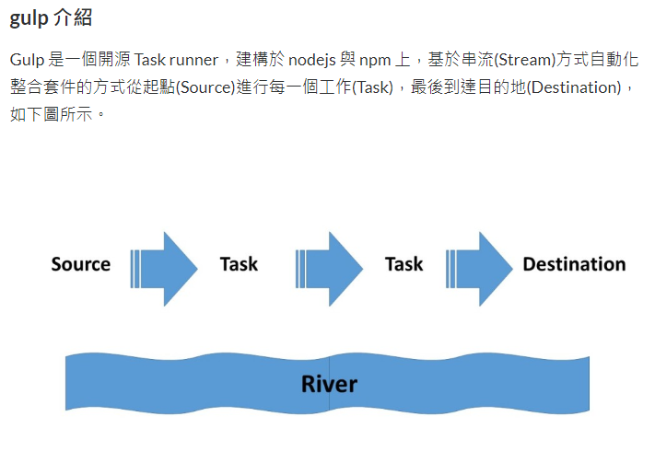
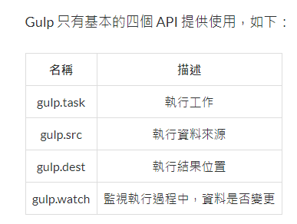
gulp-iconfont

Slide 4
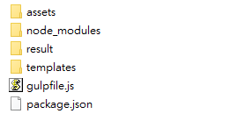
gulp-iconfont
Install gulp
npm install gulp –g
In project : npm install --save-dev gulp
Install gulp-iconfont
npm install --save-dev gulp-iconfont
npm install --save-dev gulp-consolidate
create gulpfile.js
create ./assets/icons/ folder ( put svg files )
create ./templates/tby.css ( templates css file for generate iconfont css )

Slide 5
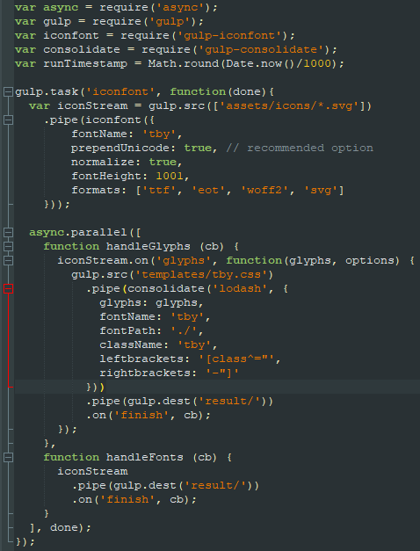
gulpfile.js

Slide 6
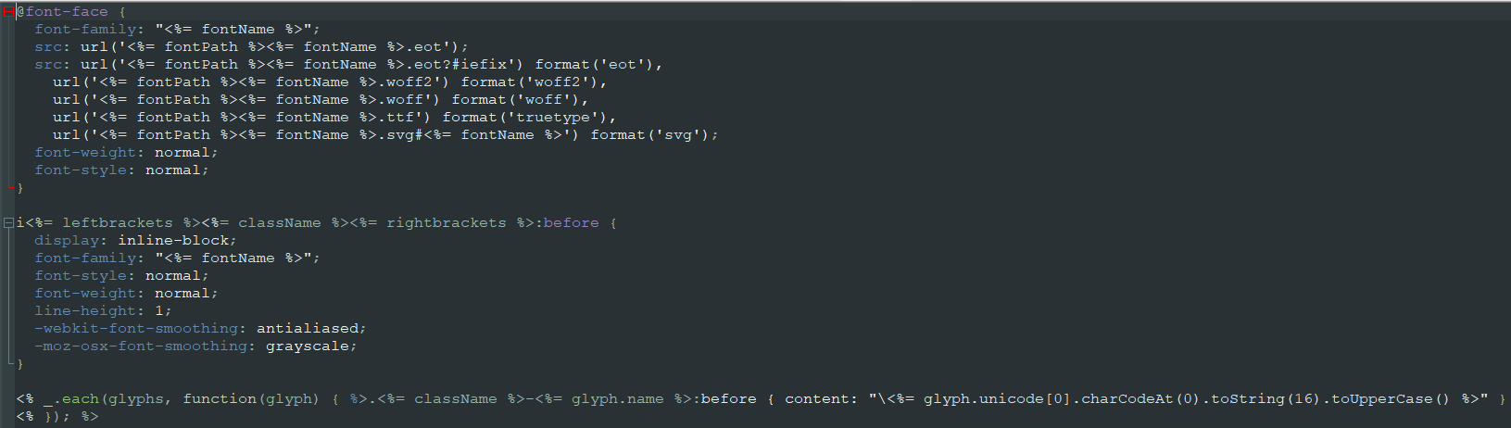
./templates/tby.css

Slide 7
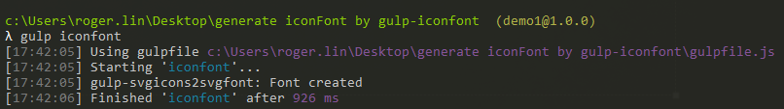
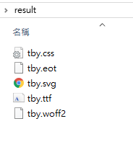
gulp-iconfont
in command line , type in gulp iconfont to generate iconfont in ./result folder
result folder have .css file , font file ( svg. ttf. woff2. eot )

Slide 8
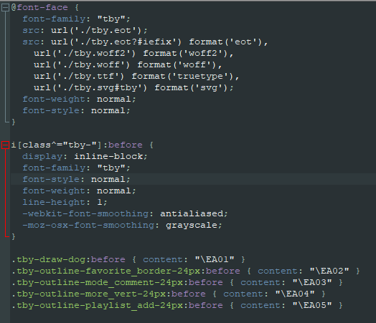
gulp-iconfont – result .css

Slide 9
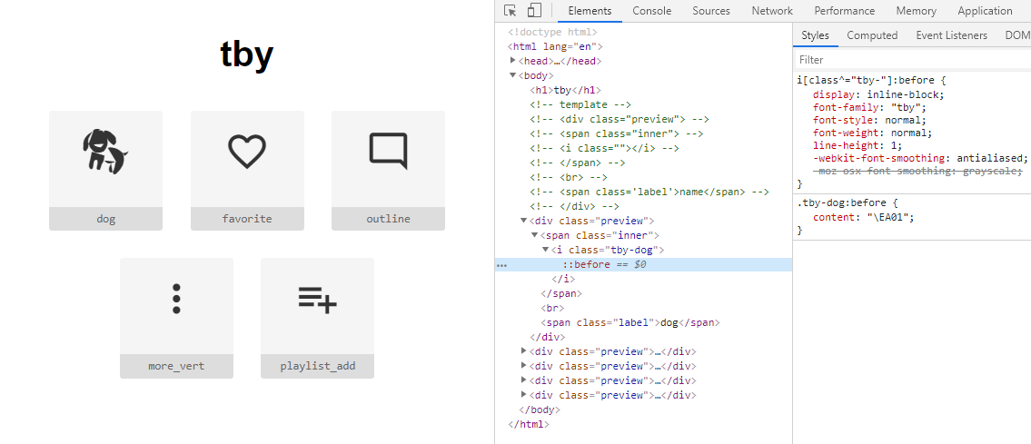
gulp-iconfont – result.html

Slide 10
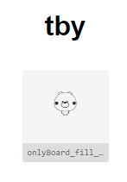
Known issue - Resolve
download from material .svg file is ok.
Ref : https://material.io/tools/icons/?style=baseline
Using vector to draw and download .svg file will display not correctly.
Ref : https://vectr.com/
The .svg file size setting : <svg xmlns="http://www.w3.org/2000/svg" width="24" height="24" viewBox="0 0 24 24">
[Resolve] the *.svg file must “fill_merge_path.svg” , thanks @Kyle
(組出來的圖片最後線要連在一起)

Slide 11
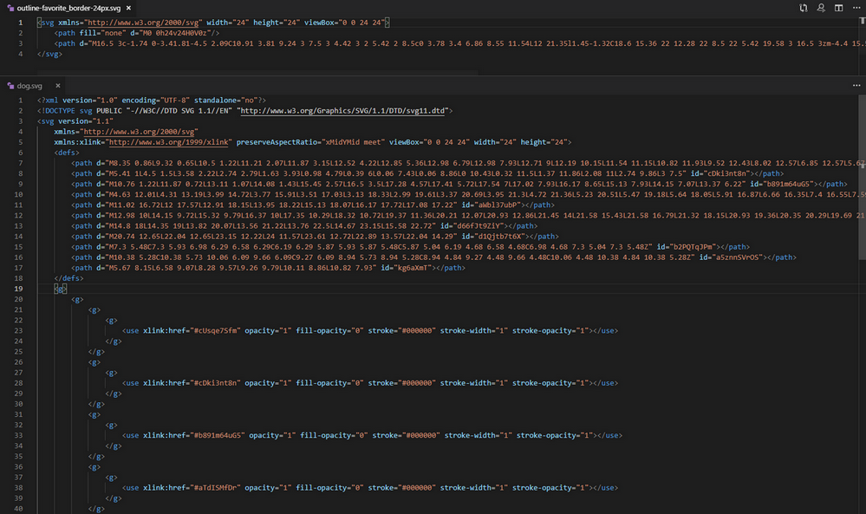
Known issue - The difference in svg file

Slide 12
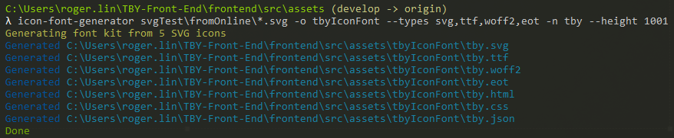
icon-font-generator
Install
npm install -g icon-font-gen
Install Python.exe
Use
-o : output icon font set files to <out> directory
--types : font types - (Defaults to 'svg, ttf, woff, woff2, eot')
-n : Name to use for generated fonts

Slide 13
reference
Svgo (compression and simplify svg) : https://jakearchibald.github.io/svgomg/
Intall gulp : https://ithelp.ithome.com.tw/articles/10185420
Draw icon web : https://vectr.com
Download icon : https://material.io/tools/icons/
Css font-face : https://blog.gtwang.org/web-development/css-font-face/
Learn svg : https://www.oxxostudio.tw/articles/201406/svg-04-path-1.html

Slide 14

2019.05.24 issue
需求 : 把 gulpfile.js 裡面的 task 抽出來各自獨立成 .js 檔案 , 在 gulpfile 呼叫 , 之後要擴充的時候比較好維護
Stack overflow 也有同樣需求
https://stackoverflow.com/questions/25518870/how-to-import-all-tasks-from-another-gulp-file-js
參考 Split tasks across multiple files 作法
https://github.com/gulpjs/gulp/blob/master/docs/recipes/split-tasks-across-multiple-files.md
把 task 拆出來遇到的問題
解決方法 : 再拆出來的 .js 檔案加 done()
Ref: https://blog.csdn.net/weixin_40817115/article/details/81079507

Slide 15
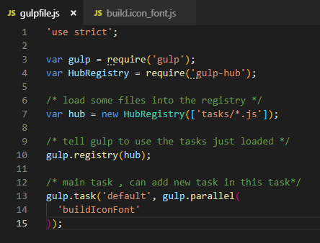
Gulpfile.js

Slide 16
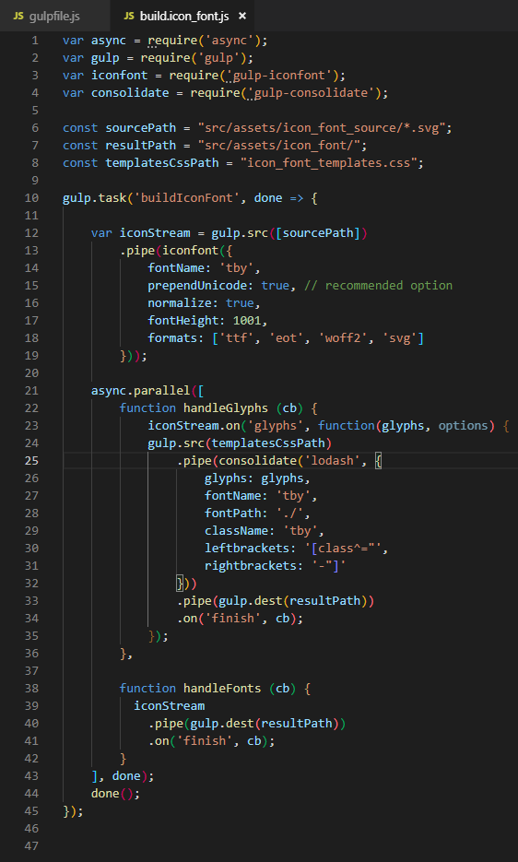
拆出來的 /tasks/build_icon_font.js
路徑如果用 ../src/assets/icon_font 這樣會吃不到
直接寫 /src/assets/icon_font 就可以

Slide 17
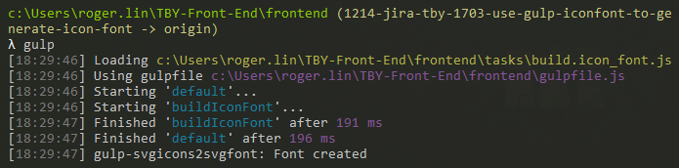
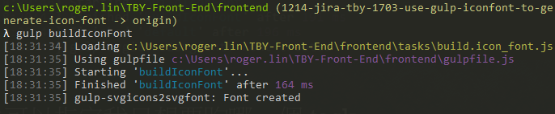
Execute
直接在 gulpfiles.js 的路徑底下輸入 gulp , 就會跑 defult 裡面要執行的 task
也可以指定我只想要跑哪一個 task

